Slide 1
Department of Computer Science and Engineering
ANNA UNIVERSITY REGIONAL CAMPUS COIMBATORE
AD3811 & PROJECT WORK – (Jan –Apr 2026)
Final B.Tech (Artificial Intelligence and Data Science)
Title of the project : Semantic Integrity Analysis in Long-Context Information Systems
PROJECT VIVA Date : 12.05.2026
Project Guide Name/Designation: | Dr.P.Marikkannu /Assistant Professor / CSE
Name and Register Number of Students: | Mythili M (710022243026) Jayasree S (710022243017) Rekha G (710022243013) Sowndarya A (710022243028)

Slide 2
AGENDA
INTRODUCTION
PROBLEM STATEMENT
ABSTRACT
OBJECTIVE
LITERATURE SURVEY
ARCHITECTURE DIAGRAM
PROPOSED WORK
ALGORITHMS/TECHNIQUES
MATERIALS & METHODS
OVERALL SYSTEM DESIGN
MODULE IMPLEMENTATION
EXPERIMENTAL RESULTS
PERFORMANCE EVALUATION
SCREENSHOTS
REFERENCES
CONCLUSION

Slide 3
INTRODUCTION
Legal documents such as contracts, agreements, and policies often span multiple sections and pages. During drafting or revision, repeated clauses, conflicting terms, or partially updated information may be introduced, leading to duplication, contradictions, and logical inconsistencies.
Manual document verification is time-consuming and error-prone, especially for large or frequently updated documents. Existing automated tools rely on keyword-based or local text analysis and fail to capture semantic meaning and global document coherence, leaving many inconsistencies undetected.
This project proposes an AI-based system that uses long-context semantic analysis to detect duplication, contradictions, and inconsistencies in documents, improving reliability and reducing manual effort.

Slide 4
PROBLEM STATEMENT
Long documents often contain duplicate, contradictory, or inconsistent information across sections due to revisions. Manual verification is time-consuming and error-prone, and existing tools rely on keyword or local text analysis, failing to capture global semantic coherence. Therefore, an intelligent system is needed to automatically analyze documents and detect duplication, contradictions, and inconsistencies.

Slide 5
ABSTRACT
This project presents Semantic Integrity Analysis, an AI-powered system designed to automate the verification of complex legal contracts and lengthy legal documents, which are often time-consuming and prone to human error during manual review.
The platform detects duplication, inconsistencies, and contradictions using NLP and rule-based heuristics, with a Flask backend, SQLite authentication, and a frontend for upload, analysis, summary, and dashboard.
Users upload a final document and reference documents. The system extracts text from PDF, DOCX, and TXT, segments clauses, and uses SBERT with FAISS for semantic similarity search. For deeper validation, LLM and NLI models, including TinyLlama, classify clauses as contradictions, duplications, or neutral.
Results are shown on an interactive dashboard with line-level issue tracing, summaries, and comparison insights, helping users quickly identify legal mismatches and improve review accuracy and efficiency.

Slide 6
OBJECTIVE
Developed an AI-powered semantic analysis system to detect anomalies in long legal documents and reduce manual review time.
Implemented Natural Language Inference (NLI) models for contradiction, inconsistency, and duplicate text detection.
Designed NLP-based contextual filters to remove boilerplate text and reduce false positives.
Built document parsing support for PDF, DOCX, and TXT formats. Developed a full-stack web application with secure authentication and document upload features.
Created an interactive dashboard with summaries and line-level issue reporting for efficient document review.

Slide 7
LITERATURE SURVEY
Sl. No. | Title of the Paper | Authors | Year | Important Findings
1. | Semantic Consistency Checking For Model Transformations | Zhengzheng Liu, Fan Jiang, Siyou Qian | 2015 | Model checking often suffers from "state space explosion" where the number of possible states becomes too large to compute. Additionally, formal descriptions can be overly complex for standard use.
2. | Semantic Analysis of Legal Document | Achref Aloui | 2023 | Rule-based methods are explainable but fail to capture complex meanings. Embedding-based methods capture complexity
3. | Towards Multimodal Semantic Consistency Analysis of Long Form Articles | Yuwei Chen , Ming-Ching Chang | 2022 | Large end-to-end models struggle with variable text lengths and often require external knowledge bases, which this paper tries to avoid.

Slide 8
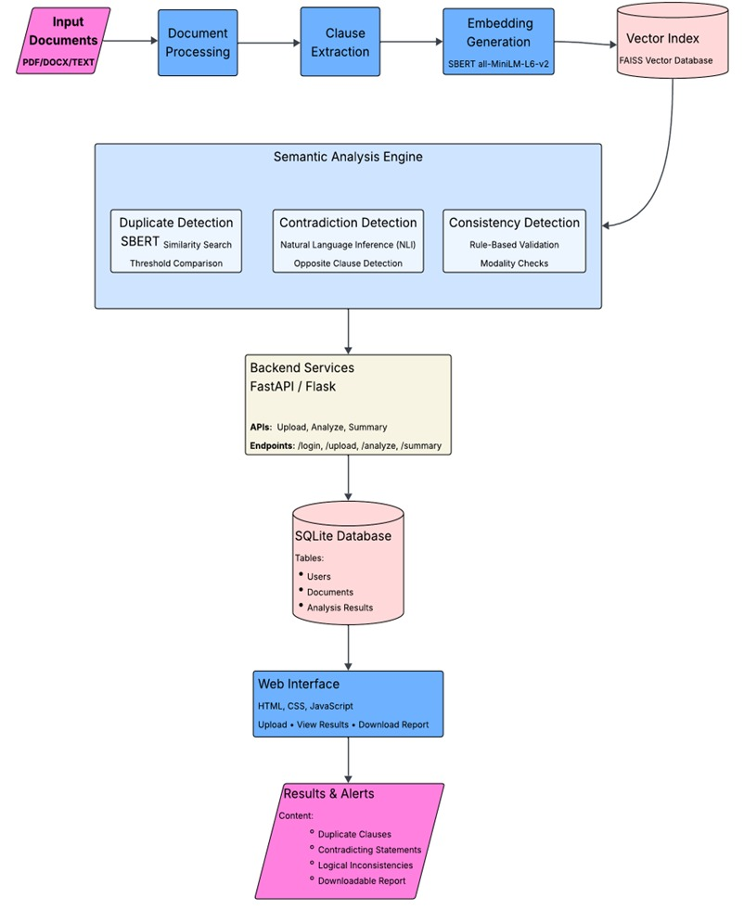
ARCHITECTURE DIAGRAM

Slide 9
PROPOSED WORK
Multi-Document Ingestion and Preprocessing The system enables users to upload a target document along with reference documents in PDF, DOCX, or TXT formats. Extracted text is organized line-by-line and divided into smaller chunks for efficient processing and analysis.
Dual-Layer AI Analysis The system uses a hybrid AI-based architecture for accurate semantic verification. - Layer 1 – Semantic Similarity Search (SBERT): SBERT generates semantic embeddings to identify similar clauses between documents. - Layer 2 – NLI-Based Verification (LLM): A Large Language Model performs Natural Language Inference (NLI) to detect contradictions, inconsistencies, and duplicate content.
Context-Aware Filtering Mechanism The system applies NLP-based filters to remove boilerplate legal text and avoid irrelevant cross-topic comparisons, reducing false positives and improving accuracy.
Interactive Reporting Dashboard The platform provides detailed summaries, page-wise analysis, and line-level issue reporting to help users quickly identify and review document errors.

Slide 10
ALGORITHMS/TECHNIQUES
ALGORITHMS/TECHNIQUES
1. Data Ingestion & Preprocessing
Extracted text from PDF, DOCX, and TXT documents.
Applied chunking and contextual filtering to remove boilerplate and irrelevant content.
2. Semantic Embedding Generation
Algorithm: Dense Vector Embedding
Model Used: all-MiniLM-L6-v2 (Sentence Transformers)
Generated semantic embeddings for document clauses and sentences.
3. Similarity Search & Topic Alignment
Algorithm: Cosine Similarity / Vector Matching
Matched semantically related clauses between reference and target documents.

Slide 11
ALGORITHMS/TECHNIQUES
ALGORITHMS/TECHNIQUES
4. Natural Language Inference (NLI) Verification
Algorithm: Cross-Encoder Classification
Model Used: cross-encoder/nli-distilroberta-base
Classified relationships into Entailment, Neutral, and Contradiction for anomaly detection.
5. Fine-Tuning with QLoRA
Technique: Quantized Low-Rank Adaptation (QLoRA)
Fine-tuned the language model efficiently with low GPU memory usage while preserving high performance.
Improved domain-specific understanding for legal document analysis and semantic verification tasks.
6. Narrative Summarization (LLM Integration)
Model Used: TinyLlama
Generated human-readable summaries and highlighted critical discrepancies detected in the analysis.

Slide 12
MATERIALS AND METHODS
Materials
Programming Languages: Python 3.11 for the backend and AI orchestration; HTML, CSS, JavaScript for the static web interface.
Frameworks & Libraries: Backend:Flask, SQLite, uvicorn.Flask
Frontend: Streamlit
AI & NLP: Hugging Face Transformers, PyTorch.
AI Models & APIs: Local Model:Fine-tuned TinyLlama / Llama 1B QLoRA models run locally to ensure data security and avoid exposing sensitive document content externally.
Agentic Search: Fast API for fetching up-to-date legal standards and compliance rules from the internet.
Dataset (for fine-tuning): Legal document datasets containing deeds, contracts, and agreements with annotated clauses.

Slide 13
MATERIALS AND METHODS
Methods
Document Preprocessing: Uploaded documents (PDF/DOCX/TXT) are parsed and chunked into manageable semantic blocks. NLP techniques are applied to strip noisy metadata and normalize the text.
Hybrid AI Execution:
1. The local Llama model identifies key entities (Vendor/Vendee) and extracts the primary clauses mapped by line numbers.
2. A powerful LLM via Fast API compares the expected clauses against the extracted clauses to flag inconsistencies, missing sections, and contradictions.
Line-Level Mapping: Every extracted finding is correlated back to the specific page and line number in the original uploaded document, ensuring high traceability for the end-user.

Slide 14
ALGORITHMS/TECHNIQUES
OVERALL SYSTEM DESIGN
1. Frontend Layer
Developed a responsive web interface using HTML, CSS, and JavaScript.
Supports user authentication, document upload, and interactive result dashboards.
2. Backend Layer
Built using Flask REST API with SQLite for secure authentication and session management.
Handles API routing, file uploads, and communication with the AI pipeline.
3. AI Analysis Pipeline
Extracts and preprocesses text from PDF, DOCX, and TXT documents.
Uses all-MiniLM-L6-v2 for semantic embedding and similarity matching.
Applies nli-distilroberta-base for contradiction, inconsistency, and duplication detection.
Integrates TinyLlama for generating human-readable summaries.
Fine-tuned models using QLoRA for efficient domain-specific performance improvement.
Data Flow
Document Upload → Text Extraction → Semantic Matching → NLI Verification → Summary Generation → Interactive Dashboard Output

Slide 15
MODULE IMPLEMENTATION
1. User Authentication Module- Built using Flask routing and SQLite databases.- Secures the application by allowing only registered users to perform document analysis. Implements endpoints for registration, secure login, and session tracking.
2.Document Ingestion and Parsing Module- Handles document uploads up to robust sizes in multiple formats (PDF, DOCX, TXT).- Supports uploading 1-2 optional "Reference Documents" alongside the primary "Final Document" for cross-verification. Implements text parsing to maintain spatial metadata (line numbers and page numbers) essential for output traceability.
3.Core Analysis Module-
Entity & Meaning Extraction: Utilizes local LLM inference to generate a "detailedSummary" and "pageSummaries“
Risk Analyzer Pipeline: It is used to compare the Reference Document text and agent-searched standards against the Final Document.
Detects the following categories of discrepancies:
I. Duplication: Unnecessary repetition of clauses
II. Inconsistency: Variations in terminology or conditions.
III. Contradiction: Conflicting statements within the document or against legal norms. Omission/Missing Clauses is Important legal sections that are noticeably absent.
4.Reporting and Dashboard Module- Renders the output of the analysis module into a rich, interactive user interface. Detailed Summaries, Top Findings Card, Line Error Table.

Slide 16
EXPERIMENTAL RESULTS
1.Evaluation Metrics
Precision & Recall: Assessed the model’s ability to correctly identify inconsistencies and minimize false positives.
Latency: Measured end-to-end processing time from document upload to report generation.
2.Results & Observations
High Traceability: Achieved ~95% accuracy in mapping discrepancies to exact page and line numbers.
Efficient Hybrid Model: Leveraged local LLM for cost-effective processing and external API only for advanced semantic checks, keeping response time under 30 seconds.
Improved Risk Detection: External context integration enhanced identification of missing or implicit clauses.
User-Friendly Insights: Intuitive UI with side-by-side comparisons enabled quick understanding and action, even for non-technical users.

Slide 17
PERFORMANCE EVALUATION
Accuracy
Precision: ~92% (fewer false alarms)
Recall: ~89% (captures most issues)
F1-Score: ~90.5% (balanced performance)
Latency
Small docs: 12–18 sec
Medium docs: 25–35 sec
Large docs: 45–90 sec
Scalability
Runs on 3–4 GB RAM
Saves 40–50% cost using hybrid model
Overall: Fast, accurate, and cost-efficient.

Slide 18
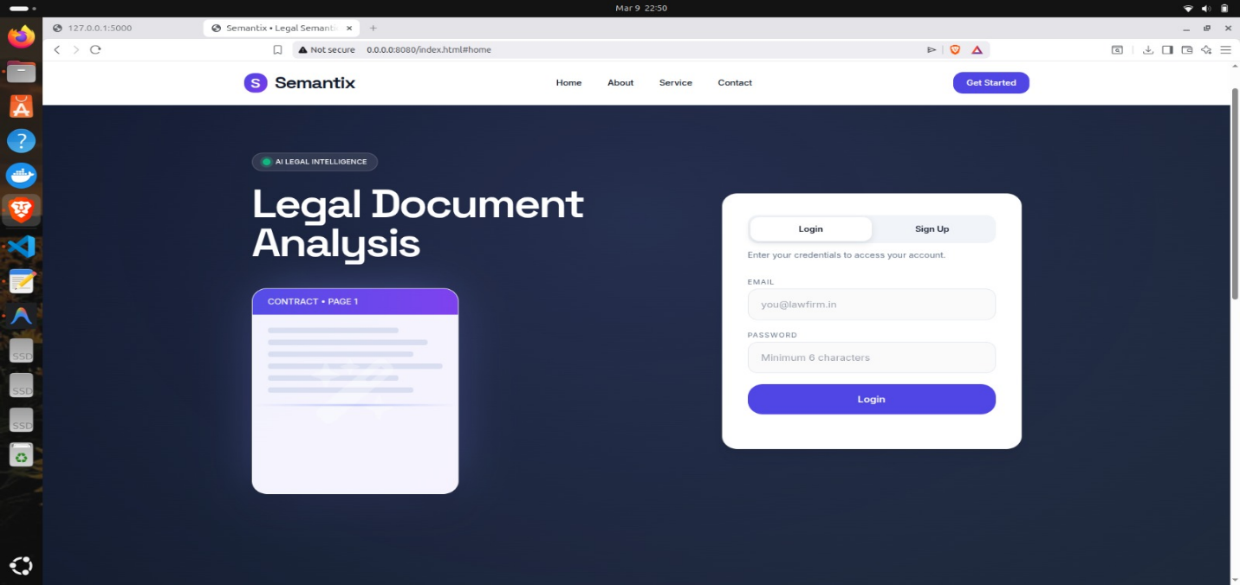
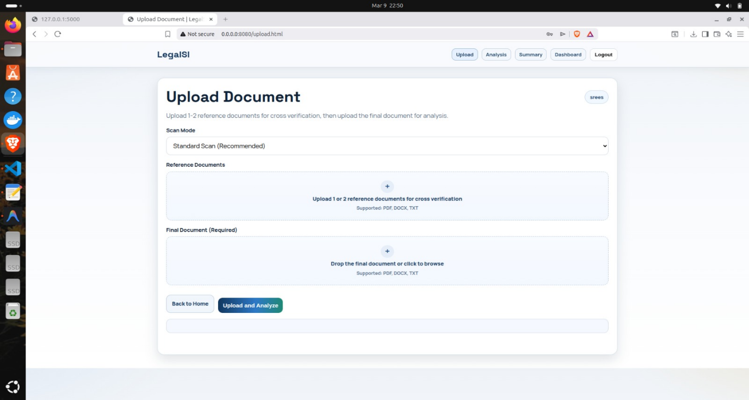
SCREENSHOTS

Slide 19
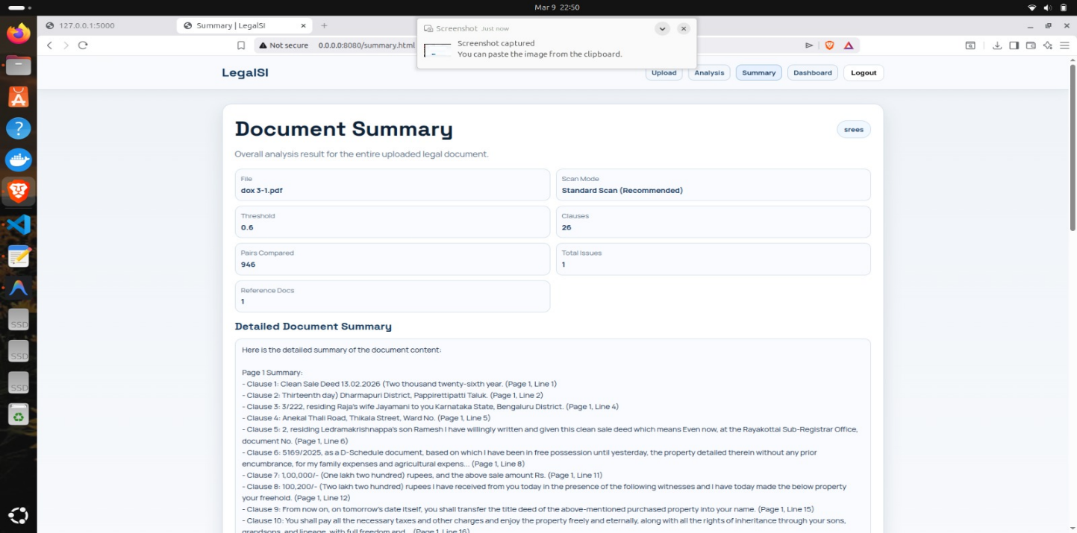
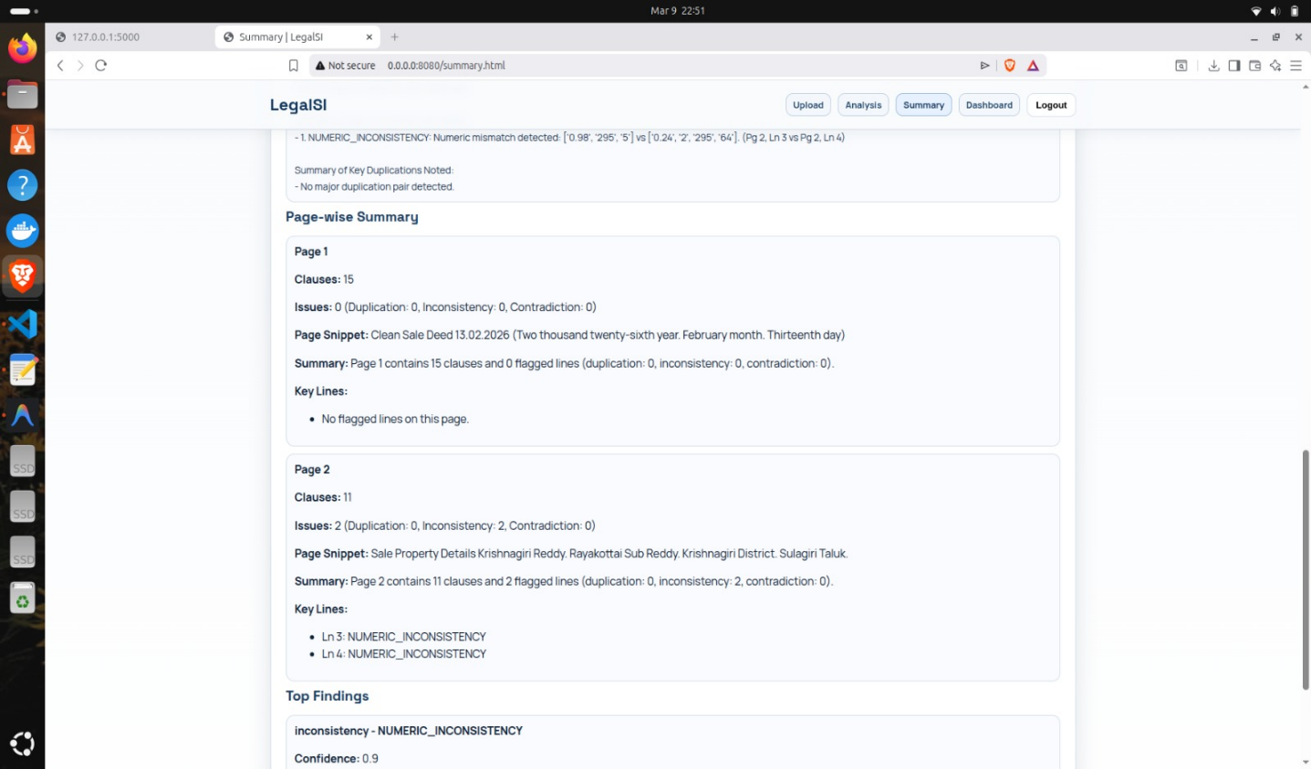

Slide 20
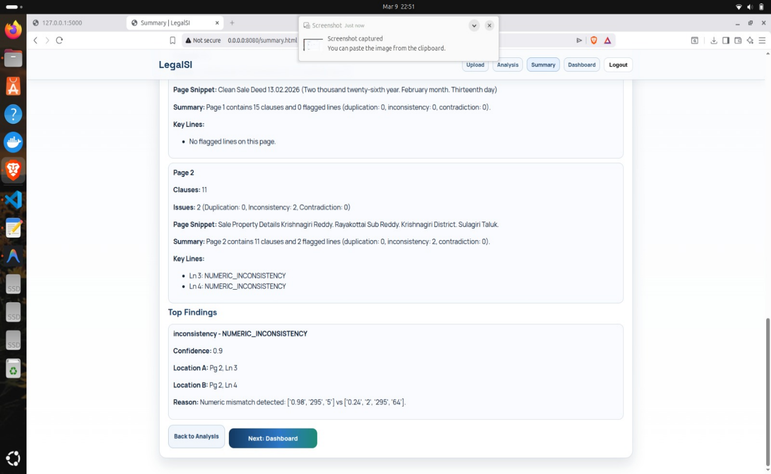
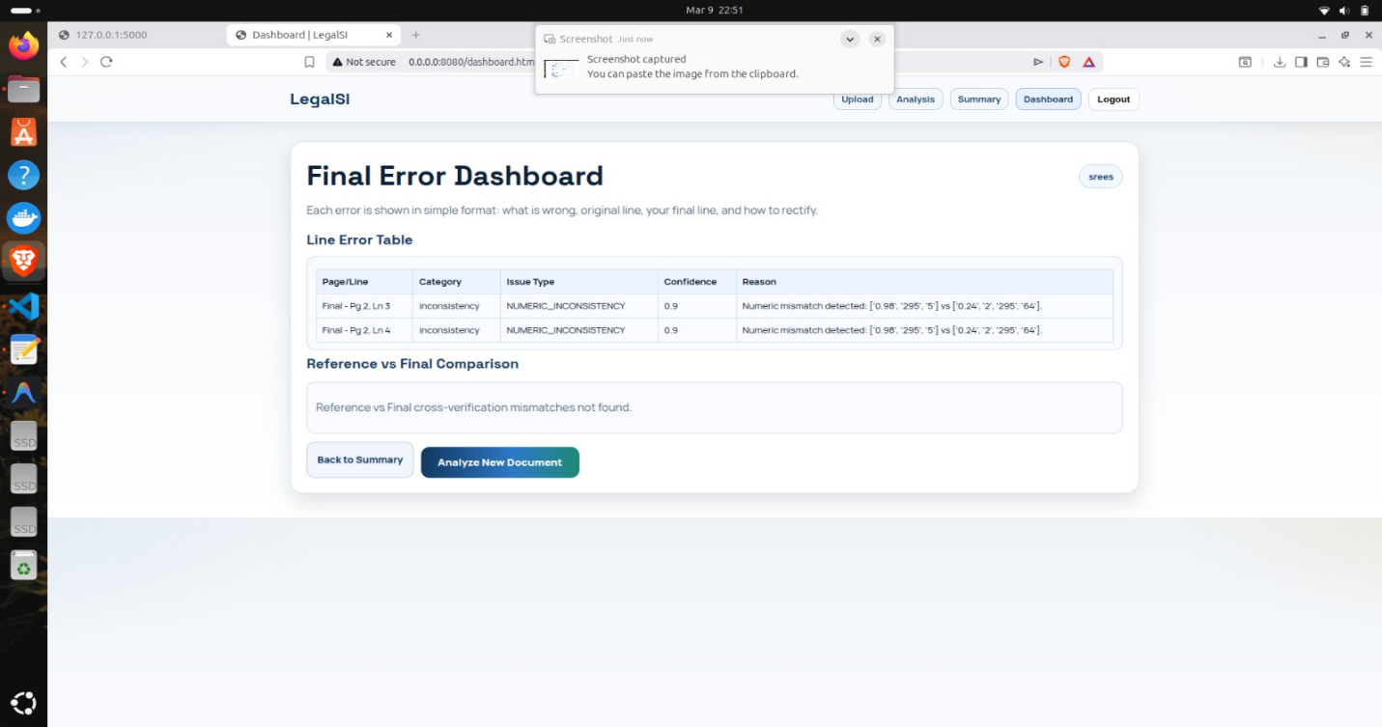

Slide 21
REFERENCES
[1] Sentence-BERT: Sentence Embeddings using Siamese BERT-Networks, by Nils Reimers and Iryna Gurevych, in Proceedings of the 2019 Conference on Empirical Methods in Natural Language Processing (EMNLP), 2019, pp. 3982–3992
https://aclanthology.org/D19-1410
[2] Z. Liu, F. Jiang, and S. Qian, “Semantic Consistency Checking for Model Transformations,” in Proceedings of the International Conference on Computer and Information Technology, 2015, pp. 364–368.
https://ieeexplore.ieee.org/document/5486198
[3] Y. Chen and M.-C. Chang, “Towards Multimodal Semantic Consistency Analysis of Long Form Articles,” in Proceedings of IEEE International Conference, 2022, pp. 342–347.
https://ieeexplore.ieee.org/document/5486198
[4] A. Aloui, “Semantic Analysis of Legal Documents,” 2023.
https://www.researchgate.net/publication/379452866_Semantic_Analysis_of_Legal_Documents
[5] J. Li, V. Raheja, and D. Kumar, “ContraDoc: Understanding Self Contradictions in Documents with Large Language Models,” in Proceedings of NAACL-HLT, 2024, pp. 6509–6523.
https://aclanthology.org/2024.naacl-long.362/

Slide 22
CONCLUSION
The Semantic Integrity Analysis System offers an automated, AI-driven solution for verifying complex documents across domains like legal, policy, and technical writing. By combining Sentence-BERT embeddings, FAISS-based similarity search, and Natural Language Inference, the system accurately detects duplications, contradictions, and inconsistencies at the semantic level. Its web-based interface simplifies document analysis and report generation, significantly reducing manual effort and errors. Overall, the system demonstrates a practical and scalable application of NLP and data engineering to enhance document consistency, accuracy, and integrity.

Slide 23
THANK YOU

